Slide 1
Banking Solutions
We are building an all-encompassing product suite specialising in DeFi solutions.

Slide 2
Introduction
“We are building an all-encompassing product suite specialising in DeFi solutions.”
These solutions include a complete banking solution, virtual card, cross border payment solution, retail and corporate banking suit, wallet (Crypto-Fiat-Crypto), decentralised exchange and a customized blockchain, which are designed for individuals and enterprise users alike.
We also offer revolutionary automated market maker built from scratch. It enables reduced slippage, cross-pairing of all tokens across every asset pool, and completely mitigates impermanent loss for liquidity providers.
blockchain catered towards an on-ramp for traditional finance use cases. It will serve as a settlement layer for financial institutions and open up new verticals in the CeFi and DeFi sectors.
Loan Management, Insurance Management to prevent loss insurance and single-side staking. Smart contract based loan and insurance solutions for banks / financial institute.

Slide 3
Overview
Payments: By establishing a decentralized ledger for payments, Our platform could facilitate faster payments at lower fees than banks.
Clearance and Settlement Systems: Distributed ledgers can reduce operational costs and bring us closer to real-time transactions between financial institutions.
Securities: By tokenizing traditional securities such as stocks, bonds, and alternative assets — and placing them on customized blockchain which create more efficient, interoperable capital markets.
Loans and Credit: By removing the need for gatekeepers in the loan and credit industry, our blockchain based solution can make it more secure to borrow money and provide lower interest rates.
Trade Finance: By replacing the cumbersome, paper-heavy bills of lading process in the trade finance industry, Our solution can create more transparency, security, and trust among trade parties globally.
Customer KYC and Fraud Prevention: By storing customer information on decentralized blocks, blockchain technology can make it easier and safer to share information between financial institutions.

Slide 4
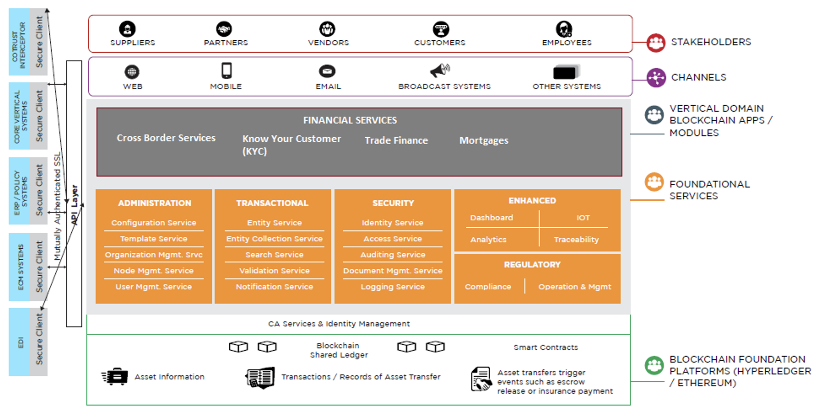
Our Platform and Services

Slide 5
Our Offerings
Retail Banking
Corporate Banking
Loan Management
E-Governance Payment
Insurance
Crypto-Banking Platform
TXN Security & Monitoring, Statutory Compliance, Supervisory & Regulatory, AML and CTF Compliance
Policy & Role Enforcement, Open API Security Enforcement, Card Management, Branch Management
Crypto Based Banking Integration,

Slide 6
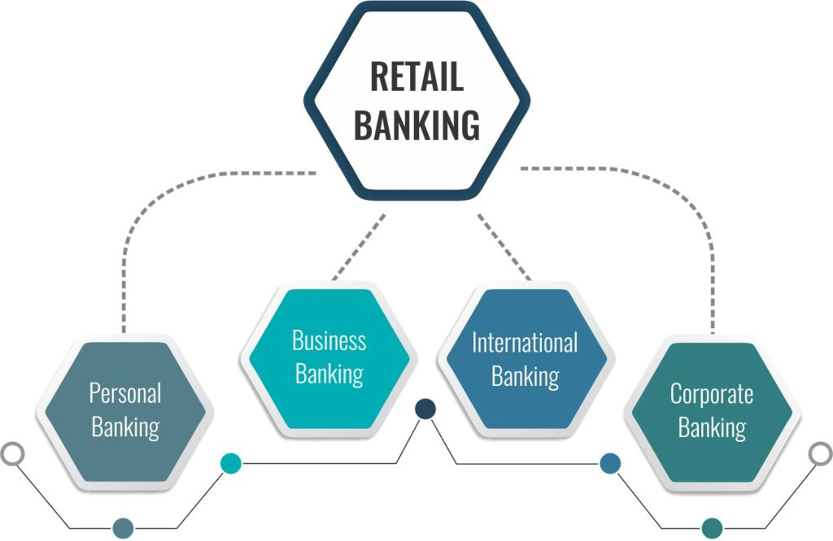
Retail Banking
Real-Time Cross-border payment solution driven by Blockchain.
Faster and cheaper transnational payments to emerging countries
KYC and AML management & compliance checks
Using digital fingerprint which, like an actual fingerprint as a unique identifier.
Identity and Transaction management
Managing identity through a secure distributed ledger.
Allows multiple levels of authentication and its real-time
Risk Assessment with the use of customer data
Data protection and anonymization by the encryption protocols of ledgers.
Risk-management decisions, banks can view data theoretically that any bank has uploaded on the network.

Slide 7
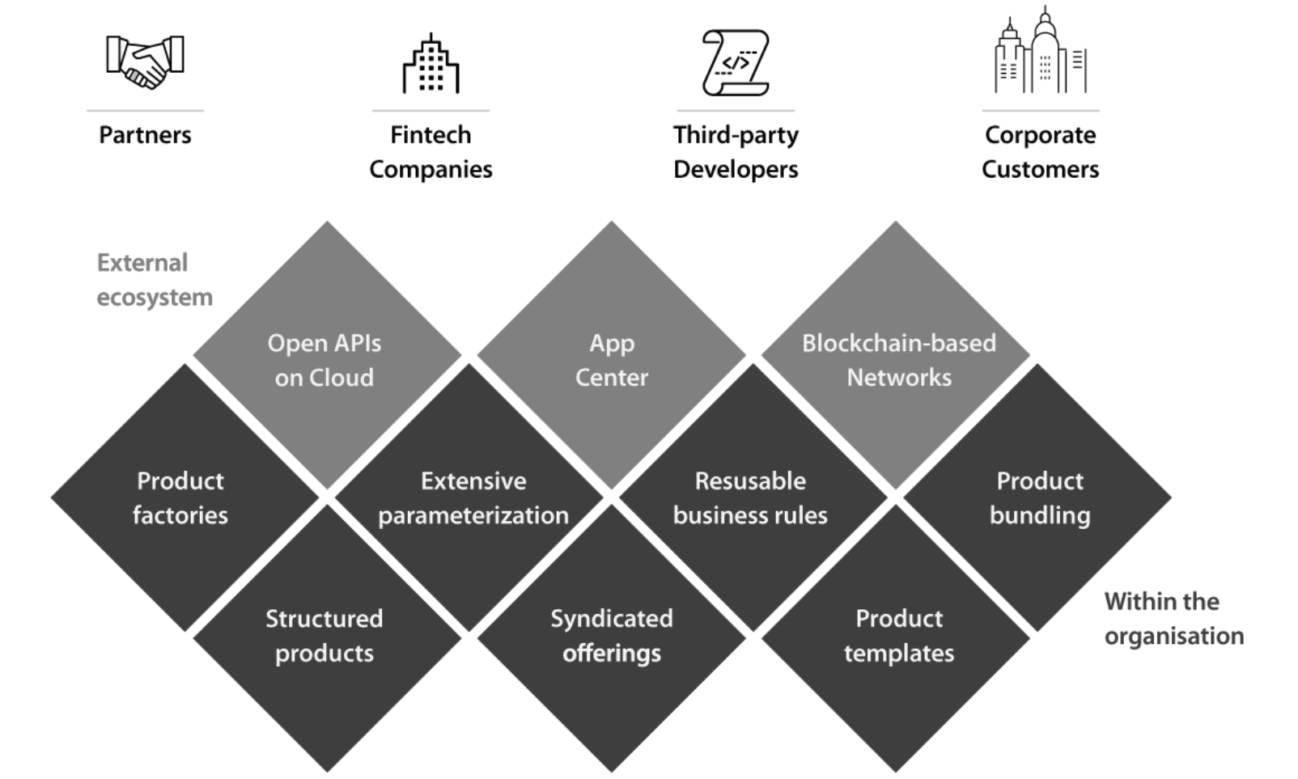
Corporate Banking
Transaction Banking with Modern Digital platform
Transaction Banking solution covering working capital, accounts services
Trade Finance by replacing cumbersome paper-heavy bills of lading
A single solution that integrates traditional trade and contemporary supply chain finance across a single common modern architecture.
Supply-Chain Management
Our solution can create more transparency, security, and trust using blockchain
Custodian and Digital Asset
Solution provides tokenized securities and allow to transfer the rights to an asset through cryptographic tokens, representing assets “off-chain”.
Clearance and Settlements
Solution for “atomic” transactions, or transactions that clear and settle as soon as a payment is made.

Slide 8
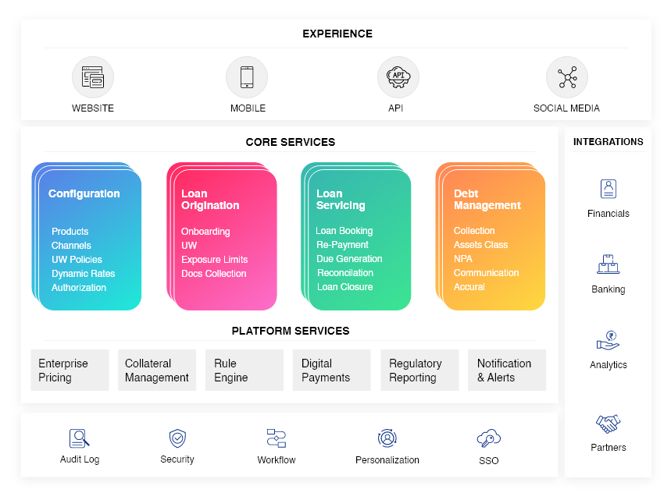
Loan Management
Lending solution backed by blockchain
The solution offers a more secure way of offering personal loans
Its cheaper, more efficient, and more secure for a larger pool of consumers.
The first live securities lending took place in 2018 with a $30.5M transaction between Credit Suisse and ING.
Multi Currency Lending platform
Lending’s platform can borrow money against any digital/crypto asset.
Mortgage Management
Linking land and properties in digital asset form to ensure risk free mortgage processing.
Loan Management System
Blockchain based loan management solution with e-KYC and AML & CTF security.

Slide 9
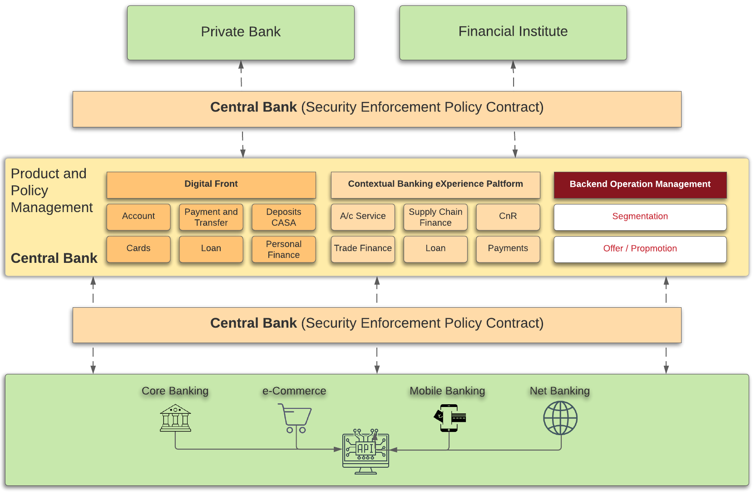
E- Governance Payment Solution
Governance Defence Layer
Our solution will manage the policies design guideline and control the policy implementation across the banking systems integrated, using smart contract based policy enforcement module.
Operation Defence Layer
The core process monitoring unit will manage automated control and data analysis, with real-time alert / notification mechanism.
Oversight Defence Layer
Smart contract based layer which will identify the fraud and risk loop-holes within policy design and enforcement. Auto generated report will provide detailed and breach alert notification.
Security Policy Enforcement
Policy Enforcement is smart contract based solution which identify and can apply a single policy to one or many banks at the same time.
International Card payment Security
The Card Policy and Security contract supports PCI DSS requirements to protect a cardholder’s information.

Slide 10

Insurance
Automated compensation
The insurance industry depends on manual processes to compensate for a lack of trust between parties.
Low-Cost Implementation
Instant policy renewals and claim pay-out reduce operational cost improve customer satisfaction.
More Efficient, High Productive
Our smart-contract based solution dramatically improve efficiency and productivity for personal lines P&C insurers.
Secure
Create an immutable and trustworthy record of products’ provenance for the benefit of all stakeholders
Access Management: Track products’ ownership and claims in real-time and even across borders
Real-Time Claim Management: Allow primary insurers, reinsurers, brokers, and regulators to share data securely in real-time.

Slide 11

Crypto Banking Platform
Global Bank Account
Offering SEPA IBAN & SWIFT IBAN account for banks to facilitate payment to customers globally.
International Debit / Credit Card
Debit and Credit card loaded with crypto and fiat currencies, that act as a global card payment system.
Multi Currency Wallet
Offering a secure multi currency wallet to store transfer and manage multiple currency with own private key set by customers.
Remittance Solution
Get a decentralized remittance platform that enables quick, secure, and efficient cross-border transactions.
Merchant Payment Gateway
Launch a trade finance platform that allows your users to seamlessly send or receive business payments from anyone in the world.

Slide 12
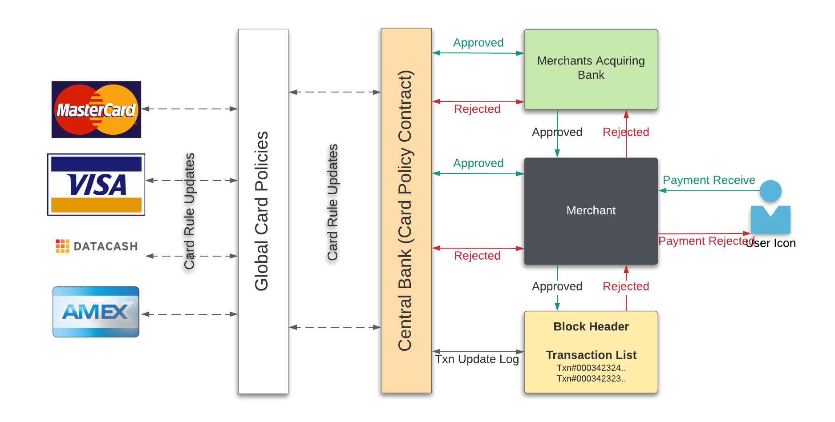
International Card Payment Security
Card Policy and Security
The Card Policy and Security contract supports PCI DSS requirements to protect a cardholder’s information.
Global Card Policies
Each policy will have a unique ID which will get auto updated with the Global Card Policies in case of any updated is published and notification will be published.
Secure Access
Our solution give operators control over what nodes can read, submit, verify and reverse transactions, it can restrict access and reduce the likelihood of outsider attacks using blockchain.
National and International policies
The central bank can define the national level policies within the Card Policy and Security contract to ensure all the transaction will be enforced to follow the same.

Slide 13
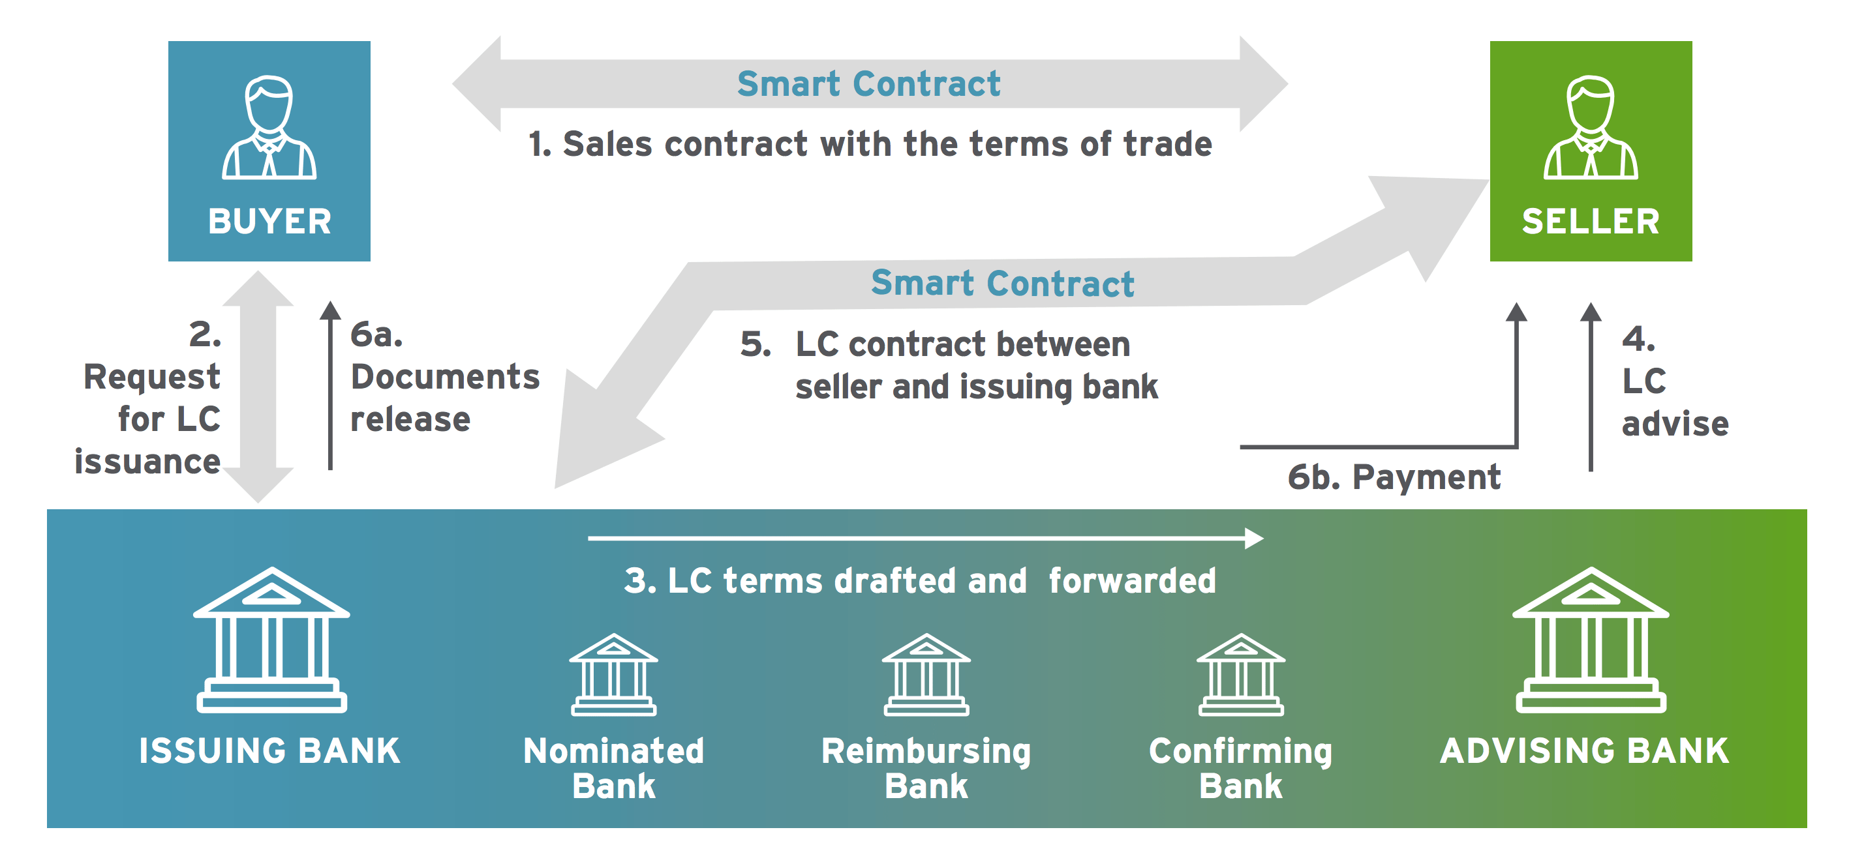
Smart Contract for Trade Finance
Current Challenges
RBI mandate the card tokenization by 2022 for all payment service provider.
Generating random tokens for all card holder in a secure way.
Securely generating tokens with formal security models and integrity checks across the service provider.
Managing tokens in a multi-domain environment within a complex ecosystem with matched signature and response back.
Securing tokens into a card data vault without any compliance fail.
Our Solution’s Benefit
Implementing its own tokenization system first in world across card network, Smart contract based Tokenization Service Provider (TSP).
Providing access to the tokenization via a modern API, e.g. cloud-friendly and RESTful API.
A one-way mathematical cryptographic hash, similar to SHA-256.
Introducing irreversible hashes imply that it must be guarantee that hashes cannot be reversed for enhanced security.

Slide 14
Card and Payment Tokenization
Merchant Acquirer/Processor
A merchant acquirer or processor first needs to select a TSP and register as a token requestor (TR).
Token Service Providers
Infrastructure and Information ready solution involves defining and codifying token presentment modes for token-based transactions at the point of sale.
Multi-Pay Tokens
A multi-pay token is unique to a specific card used with a specific merchant these tokens are especially useful in CNP ( i.e. Monthly Bill Payment, e-commerce, etc.) transactions.
Data Storage
To help prevent potential breaches and reduce PCI scope and maintenance costs, merchants can use tokens to completely remove legacy and stored primary account numbers (PANs) in the card data environment (CDE).

Slide 15

Thank You!
Contact Us
India
IntelOra Resources and Developments LLP Sai Priya Environ, Electronic City Phase 1, Bengaluru, Karnataka. Pin Code: 560100
USA
IntelOra Resources and Developments LLC 4293 N. Placita De Susana, Tucson, Arizona. USA. Zipp Code: 85718
E-Mail
info@intelora.co.in
Call / WhatsApp
(0091)-930-604-9136

